Slide 1
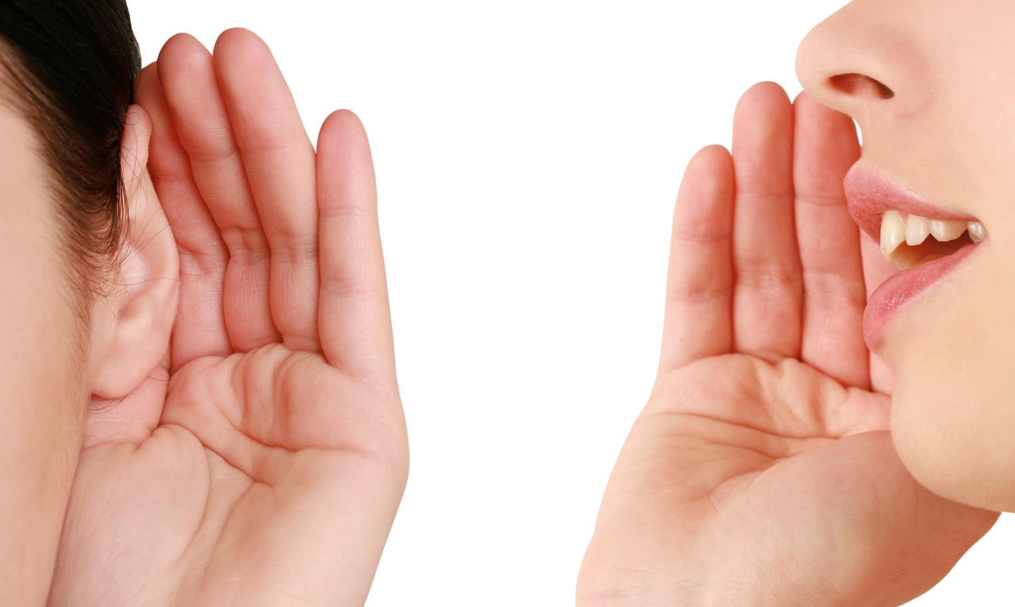
Words That Work
Phrases that encourage major & planned gifts

Slide 2
Results from 20 survey groups including over 14,000 total participants collected during 2013-2016 with one goal:
To uncover the messages and phrases that work to encourage planned & major gifts

Slide 3
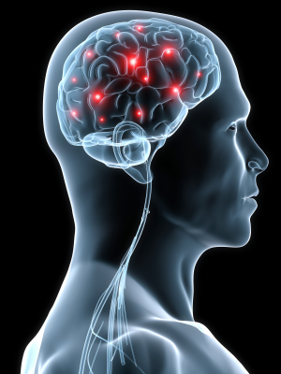
Philanthropy as synthetic family
Philanthropy is a SOCIAL act using the mechanisms of FAMILY bonding

Slide 4
Philanthropy uses family bonding mechanisms
Charitable giving is rewarding (like receiving money)
But uniquely involves oxytocin-rich social attachment brain regions (used in maternal and romantic love)
“donating to societal causes recruited two types of reward systems: the VTA–striatum mesolimbic network, which also was involved in pure monetary rewards, and the subgenual area, which was specific for donations and plays key roles in social attachment and affiliative reward mechanisms in humans and other animals.” Moll, et al (2006) PNAS 103(42), p. 156234.

Slide 5
Philanthropy uses family bonding mechanisms
Increasing neuropeptide “oxytocin” – a family bonding hormone –increases giving
Zak, P. J., Stanton, A. A., & Ahmadi, S. (2007). Oxytocin increases generosity in humans. PLoS ONE, 11, e1128

Slide 6
Philanthropy uses family bonding mechanisms
Human touch, when followed by a small gift, elevated oxytocin levels AND subsequent charitable giving
Morhenn, V. B., Park, J. W., Piper, E., Zak, P. J. (2008). Monetary sacrifice among strangers is mediated by endogenous oxytocin release after physical contact. Evolution and Human Behavior, 29, 375-383.

Slide 7
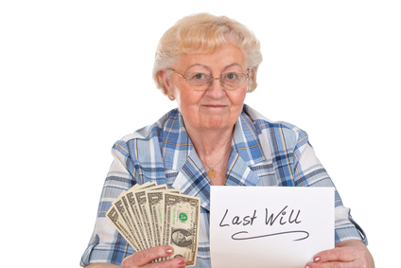
Charitable estate giving as “synthetic family”
The strongest predictor of charitable bequest planning is childlessness
James, R. N., III. (2009). Health, wealth, and charitable estate planning: A longitudinal examination of testamentary charitable giving plans. Nonprofit and Voluntary Sector Quarterly, 38(6), 1026-1043.

Slide 8
Philanthropy is a “social act”
Charitable giving generated greater activation in brain reward centers (ventral striatum) when observers were present
Izuma, K., Saito, D. N., & Sadato, N. (2010). Processing of the Incentive for Social Approval in the Ventral Striatum during Charitable Donation. Journal of Cognitive Neuroscience, 22 (4), 621-631.
Notes:
Charitable giving appears to be a substitute for giving to family members when you don’t have them nearby.

Slide 9
Philanthropy as synthetic family
Philanthropy is a SOCIAL act using the mechanisms of FAMILY bonding

Slide 10
Build family-social relationships,
not market-contract relationships
Do you call?
Do you write? Do you visit?
Are you closer to extended family members who do these things?

Slide 11
Family words
(simple language and life stories)
outperform
formal words
(technical, contract, market terms)
Philanthropy is a SOCIAL act using the mechanisms of FAMILY bonding

Slide 12
Use family language
Stories and simple words
Avoid market language
Formal, legal, or contract terms
Social Realm
(identity)
I help people because of who I am
Market Realm
(exchange)
I engage in transactions by formal contract
Would you say it in a normal conversation with your grandmother?

Slide 13
Describing a CRT
Make a
gift
Make a transfer of assets
where you get an immediate tax deduction, still control the investment of the assets and receive income from the investments for the rest of your life with anything left over going to charity at your death.
where you get an immediate tax deduction, still control the investment of the assets and receive income from the investments for the rest of your life with anything left over going to charity at your death.
Different groups rate their interest after receiving different descriptions
Does it make much difference?

Slide 14
Make a transfer of assets
where you get an immediate tax deduction, still control the investment of the assets and receive income from the investments for the rest of your life with anything left over going to charity at your death.
Make a gift
where you get an immediate tax deduction, still control the investment of the assets and receive income from the investments for the rest of your life with anything left over going to charity at your death.
2014 Survey (A/B)
1,101 Respondents

Slide 15
Describing a CGA
Make a
gift
Enter into a contract with a charity where you transfer your cash or property
and in exchange receive a guaranteed lifetime income from the charity.
and in exchange receive a guaranteed lifetime income from the charity.
Does it make much difference?

Slide 16
Enter into a contract with a charity where you transfer your cash or property and in exchange
receive a guaranteed lifetime income from the charity
Make a gift and in exchange receive a guaranteed lifetime income from the charity
2014 Survey (A/B)
1,101 Respondents

Slide 17
Formal terms lower charitable interest
2014 Survey, 1,417 Respondents, Group F/G
Will Never Be Interested
14%
23%
Interested Now
36%
22%
Get an immediate tax deduction and still receive income from your investments for the rest of your life by making a gift where you control the investment of the assets, but anything left over goes to charity at your death.
Get an immediate tax deduction and still receive income from your investments for the rest of your life by making a gift
using a “Charitable Remainder Trust”
where you control the investment of the assets, but anything left over goes to charity at your death.

Slide 18
Formal terms lower charitable interest
2014 Survey, 1,418 Respondents, Group F/G
Will Never Be Interested
8%
19%
Interested Now
50%
23%
Receive a tax deduction and make a gift that pays you income for life
Receive a tax deduction and make a gift that pays you income for life
called a “Charitable Gift Annuity”

Slide 19
Formal terms lower charitable interest
2014 Survey, 1,422 Respondents, Group F/G
Will Never Be Interested
23%
30%
Interested Now
26%
15%
Immediately receive a tax deduction for 70% of the value of a house or land by making a charitable gift of the property,
but keeping the right to use it for the rest of your life.
Immediately receive a tax deduction for 70% of the value of a house or land by making a charitable gift of the property,
using a “Remainder Interest Deed”
but keeping the right to use it for the rest of your life.

Slide 20
Formal terms lower charitable interest
2014 Survey, 1,246 Respondents, Groups D/E
Will Never Be Interested
12%
14%
Interested Now
23%
12%
Make a gift to charity in my will
Make a bequest gift to charity

Slide 21
Drop in “Interested Now” with formal terms
Phrase | Women | Men | 50+
“bequest gift” | -14.2% | -7.3% | -13.0%
“Enter into a contract with a charity…” | -19.2% | -11.8% | -9.7%
“using a Remainder Interest Deed” | -12.6% | -9.3% | -7.4%
“called a Charitable Gift Annuity” | -25.6% | -26.9% | -20.1%
“using a Charitable Remainder Trust” | -12.9% | -14.7% | -10.2%
“Make a transfer of assets…” | -12.0% | -12.8% | -4.9%

Slide 22
New Research Questions
How should you describe these in a way that people are most interested in learning more?
CGAs
General planned giving information
Bequest gifts
General estate planning
Tax benefits
How should you describe them in a way that more people actually understand what you mean?

Slide 23
How do you say “CGA” so that people will want to know more?

Slide 24
Suppose you are viewing the website of a charity representing a cause that is important in your life. In addition to a “Donate Now” button, the following buttons appear on the website. Please rate your level of interest in clicking on the button to read the corresponding information.
I am definitely NOT interested
I don’t think I would be interested
I don’t know if I would be interested
I might be interested
I am definitely interested

Slide 25
Survey #1: 2,550 respondents assigned to 5 different surveys
I am definitely interested
__%
__%
__%
__%
__%
Charitable gift annuities
Life income gifts
Get a tax deduction and make a gift that pays you income for life
Gifts that pay you income for life
Gifts that pay you income

Slide 26
Survey #1: 2,550 respondents assigned to 5 different surveys
I am definitely interested
5%
9%
26%
28%
29%
Charitable gift annuities
Life income gifts
Get a tax deduction and make a gift that pays you income for life
Gifts that pay you income for life
Gifts that pay you income

Slide 27
Does this differ for people of different ages, or for people who make substantial donations to charity?

Slide 28
Group Differences
Donor
All
5%
9%
26%
28%
29%
55+
4%
11%
22%
25%
23%
$1k+
5%
10%
26%
27%
26%
I am definitely interested
Charitable gift annuities
Life income gifts
Get a tax deduction and make a gift that pays you income for life
Gifts that pay you income for life
Gifts that pay you income

Slide 29
Is there a better variation of “Gifts that pay you income”?
Survey #2
(2,750 respondents)

Slide 30
Survey #1: 2,750 respondents assigned to 5 different surveys
I am definitely interested
__%
__%
__%
__%
__%
Gifts that pay you income
Gifts that pay you guaranteed income
Gifts that pay you
Gifts that pay you income and avoid taxes
Gifts that pay

Slide 31
Survey #1: 2,750 respondents assigned to 5 different surveys
I am definitely interested
30%
30%
29%
26%
24%
Gifts that pay you income
Gifts that pay you guaranteed income
Gifts that pay you
Gifts that pay you income and avoid taxes
Gifts that pay

Slide 32
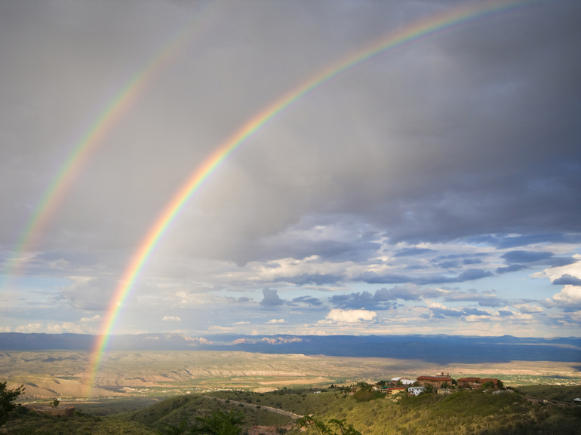
What does it mean?
When you click on the phrase, what do you think you are going to see?

Slide 33
Which of the following types of information would you expect when clicking on the button labeled "__[CGA Term]__"
“How to make a gift and, in return, receive lifetime income from the charity”
I definitely did NOT expect this
I didn't really expect this
I don't know if I expected this or not
I guess I expected this
I definitely expected this

Slide 34
“How to make a gift and, in return, receive lifetime income from the charity”
I definitely expected this
Which of the following types of information would you expect when clicking on the button labeled "_______"
__%
__%
__%
__%
__%
Charitable gift annuities
Life income gifts
Gifts that pay you income
Get a tax deduction and make a gift that pays you income for life
Gifts that pay you income for life

Slide 35
“How to make a gift and, in return, receive lifetime income from the charity”
I definitely expected this
Which of the following types of information would you expect when clicking on the button labeled "_______"
15%
24%
30%
31%
34%
Charitable gift annuities
Life income gifts
Gifts that pay you income
Get a tax deduction and make a gift that pays you income for life
Gifts that pay you income for life

Slide 36
Combined Results
“How to make a gift and, in return, receive lifetime income from the charity”
I am definitely interested
I definitely expected this
__%
__%
__%
__%
__%
__%
__%
__%
__%
__%
Charitable gift annuities
Life income gifts
Get a tax deduction and make a gift that pays you income for life
Gifts that pay you income for life
Gifts that pay you income

Slide 37
Combined Results
“How to make a gift and, in return, receive lifetime income from the charity”
I am definitely interested
I definitely expected this
5%
9%
26%
28%
30%
15%
24%
31%
34%
30%
Charitable gift annuities
Life income gifts
Get a tax deduction and make a gift that pays you income for life
Gifts that pay you income for life
Gifts that pay you income

Slide 38
What is the best “front door” phrase to get people to read about planned giving information?
They have to be interested in finding out more
They have to expect to see planned giving information (i.e., not “bait and switch”)

Slide 39
What is the best “front door” phrase to get people to read about planned giving information?
They have to be interested in finding out more
Suppose you are viewing the website of a charity representing a cause that is important in your life. In addition to a “Donate Now” button, the following buttons appear on the website. Please rate your level of interest in clicking on the button to read the corresponding information.

Slide 40
Survey #1: 2,550 respondents
I am definitely interested
__%
__%
__%
__%
__%
__%
Gift planning
Planned giving
Giving now & later
Other ways to give
Other ways to give smarter
Other ways to give cheaper, easier, and smarter

Slide 41
Survey #1: 2,550 respondents
I am definitely interested
3%
4%
7%
16%
20%
23%
Gift planning
Planned giving
Giving now & later
Other ways to give
Other ways to give smarter
Other ways to give cheaper, easier, and smarter

Slide 42
Is there a better way to phrase,
“Other ways to give cheaper, easier, and smarter”?
Survey #2
(2,750 respondents)

Slide 43
Survey #2: 2,750 respondents
I am definitely interested
__%
__%
__%
__%
__%
Other gifts
More ways to give
Give other ways
How to give cheaper, easier, and smarter
Other ways to give cheaper, easier and smarter

Slide 44
Survey #2: 2,750 respondents
I am definitely interested
8%
14%
15%
21%
22%
Other gifts
More ways to give
Give other ways
How to give cheaper, easier, and smarter
Other ways to give cheaper, easier and smarter

Slide 45
What is the best “front door” phrase to get people to read about planned giving information?
They have to expect to see planned giving information (i.e., not “bait and switch”)
Which of the following types of information would you expect when clicking on the button labeled "_______"

Slide 46
Which of the following types of information would you expect when clicking on the button labeled "_______“? How to…
12 types of planned giving information
make a gift of stocks
make a gift of bonds
make a gift of real estate
make a gift in your will
make a gift in your living trust
make a gift by naming a charity as death beneficiary of your life insurance policy
make a gift by naming a charity as death beneficiary of your IRA or retirement account
make a gift by naming a charity as death beneficiary of your bank account
make a gift and, in return, receive lifetime income from the charity
avoid capital gains taxes by making charitable gifts
avoid estate taxes by making charitable gifts
avoid income taxes by making charitable gifts

Slide 47
Overall average for all 12 types of planned giving information
I definitely expected this
__%
__%
__%
__%
__%
__%
Gift planning
Planned giving
Giving now & later
Other ways to give
Other ways to give smarter
Other ways to give cheaper, easier, and smarter

Slide 48
Overall average for all 12 types of planned giving information
I definitely expected this
20%
12%
7%
15%
19%
12%
Gift planning
Planned giving
Giving now & later
Other ways to give
Other ways to give smarter
Other ways to give cheaper, easier, and smarter

Slide 49
Combined Results
12 types of PG info average
I am definitely interested
I definitely expected this
3%
4%
7%
16%
20%
23%
20%
12%
7%
15%
19%
12%
Gift planning
Planned giving
Giving now & later
Other ways to give
Other ways to give smarter
Other ways to give cheaper, easier, and smarter

Slide 50
How should you say that you want to share information about making a gift in a will?

Slide 51
I might be/
am definitely interested
__%
__%
__%
__%
__%
__%
__%
Gifts in wills
Gifts in a will
Tax tips for gifts in a will
How to make gifts in a will
Gifts in your will
Will planning
Bequest gifts

Slide 52
I might be/
am definitely interested
26%
26%
27%
27%
28%
28%
18%
Gifts in wills
Gifts in a will
Tax tips for gifts in a will
How to make gifts in a will
Gifts in your will
Will planning
Bequest gifts

Slide 53
Previous finding (2014 survey)
2014 Survey, 1,246 Respondents, Groups D/E
Will Never Be Interested
12%
14%
Interested Now
23%
12%
Make a gift to charity in my will
Make a bequest gift to charity

Slide 54
Don’t use “Bequest”
2014 Survey, 1,203 Respondents, Groups D/C
Will Never Be Interested
26%
31%
Interested Now
12%
9%
Make a gift by naming a charity as a transfer-on-death beneficiary on a bank account or retirement account.
Make a bequest gift by naming a charity as a beneficiary on a bank account or retirement account.

Slide 55
What about broader estate planning terms?

Slide 56
I might be/
am definitely interested
__%
__%
__%
__%
__%
__%
Will planning
Legacy planning
Legacy giving
Planning with trusts & estates
Estate planning
Estate giving

Slide 57
I might be/
am definitely interested
28%
18%
18%
17%
16%
14%
Will planning
Legacy planning
Legacy giving
Planning with trusts & estates
Estate planning
Estate giving

Slide 58
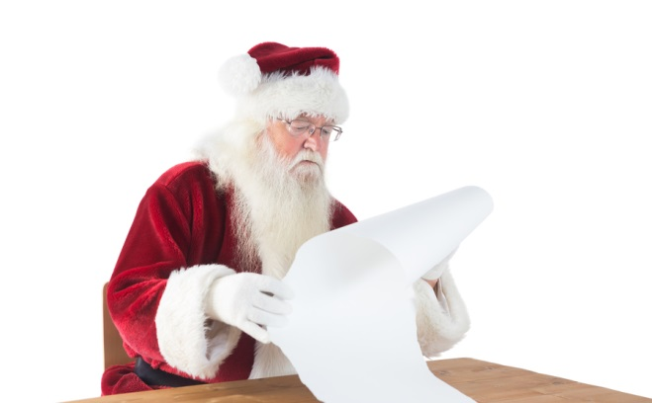
Instead of a broad estate planning term, what about a long list of several terms?

Slide 59
I might be/
am definitely interested
__%
__%
__%
__%
Gifts in wills
Gifts in wills, trusts, or retirement accounts
Gifts in wills, trusts, retirement accounts, or life insurance
Gifts in wills & trusts

Slide 60
I might be/
am definitely interested
26%
25%
24%
23%
Gifts in wills
Gifts in wills, trusts, or retirement accounts
Gifts in wills, trusts, retirement accounts, or life insurance
Gifts in wills & trusts

Slide 61
Do people expect to see a broad range of estate planning information?
How to make a gift in your will
How to make a gift in your living trust
How to make a gift by naming a charity as death beneficiary of your life insurance policy
How to make a gift by naming a charity as death beneficiary of your IRA or retirement account
How to make a gift by naming a charity as death beneficiary of your bank account

Slide 62
Gifts
in wills
82%
49%
51%
48%
52%
Gifts in wills, trusts, retirement accounts or life insurance
80%
76%
63%
59%
50%
I definitely/ guess I expected this
Estate Planning
64%
53%
48%
46%
46%
Make a gift in your will
Make a gift in your living trust
Make a gift by naming a charity as death beneficiary of your life insurance policy
Make a gift by naming a charity as death beneficiary of your IRA or retirement account
Make a gift by naming a charity as death beneficiary of your bank account

Slide 63
26%
16%
24%
I might be/am definitely interested
Gifts in wills
82%
49%
51%
48%
52%
Estate Planning
64%
53%
48%
46%
46%
Gifts in wills, trusts, retirement accounts or life insurance
80%
76%
63%
59%
50%
Make a gift in your will
Make a gift in your living trust
Make a gift by naming a charity as death beneficiary of your life insurance policy
Make a gift by naming a charity as death beneficiary of your IRA or retirement account
Make a gift by naming a charity as death beneficiary of your bank account

Slide 64
Use
family words
(simple language and life stories)
not formal words
(technical, contract, market terms)
Philanthropy is a SOCIAL act using the mechanisms of FAMILY bonding

Slide 65
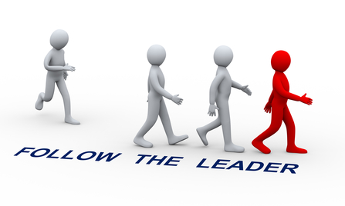
Philanthropy is a SOCIAL act using the mechanisms of FAMILY bonding
SOCIAL examples influence charitable
estate decisions

Slide 66
3,000 testators in the normal process of completing their wills were randomly assigned to one of three groups
1
2
3
No reference to charity
Would you like to leave any money to charity in your will?
Many of our customers like to leave money to charity in their will. Are there any causes you’re passionate about?
Cabinet Office Behavioural Insights Team (2013) Applying behavioural insights to charitable giving

Slide 67
Charitable bequests are influenced by a simple social example
15.4%
10.4%
5.0%
Charitable plans among
1,000 testators
Charitable plans among
1,000 testators
Charitable plans among
1,000 testators
No reference to charity
Would you like to leave any money to charity in your will?
Many of our customers like to leave money to charity in their will. Are there any causes you’re passionate about?
Cabinet Office Behavioural Insights Team (2013) Applying behavioural insights to charitable giving

Slide 68
The social example also increased the average amount of bequest gifts
$11,333
$5,610
$5,291
Charitable plans among
1,000 testators
Charitable plans among
1,000 testators
Charitable plans among
1,000 testators
No ask
Simple Ask
Social Norm
Cabinet Office Behavioural Insights Team (2013) Applying behavioural insights to charitable giving
Using £1=$1.70 exchange rate

Slide 69
The social norm increased charitable bequest intentions
2014 Survey, 2,369 Respondents, Groups D/E/LateG+H
Will Never Be Interested
9%
12%
14%
Interested Now
31%
23%
12%
Many people like to leave a gift to charity in their will. Are there any causes you would support in this way?
Make a gift to charity in my will
Make a bequest gift to charity

Slide 70
Testing Charitable Gift Annuity Ad Messages

Slide 71
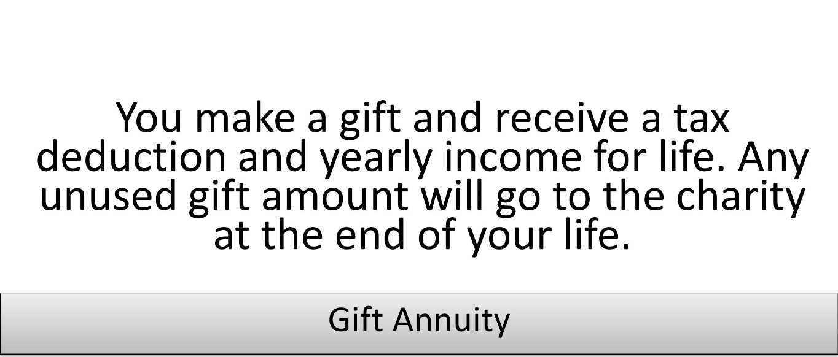
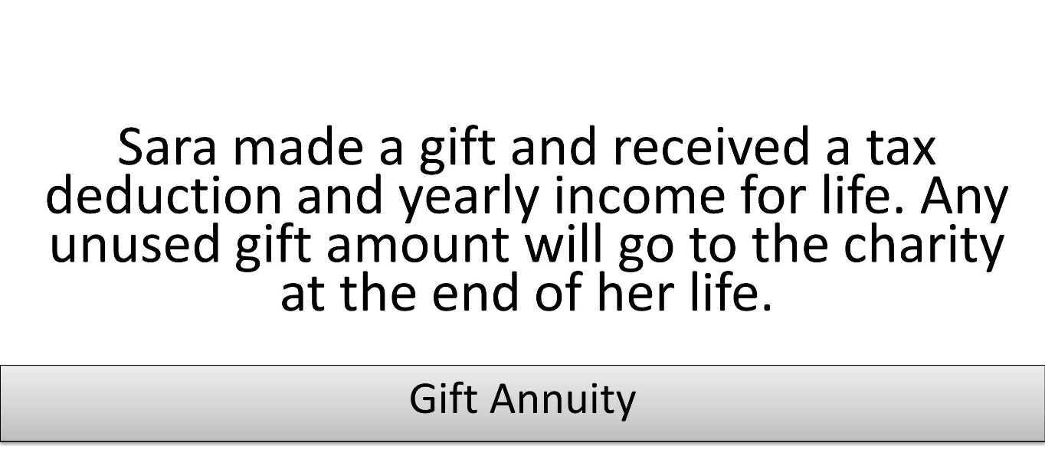
What “you” would do or what another donor has done?
Interested Now
Definitely/somewhat/slightly
All: ____%
55+: ____%
All: ____%
55+: ____%
Please rate your interest in pursuing the above described charitable giving arrangement

Slide 72
What “you” would do or what another donor has done?
Interested Now
Definitely/somewhat/slightly
All: 33.5%
55+: 23.2%
All: 38.6%
55+: 38.6%
Please rate your interest in pursuing the above described charitable giving arrangement

Slide 73
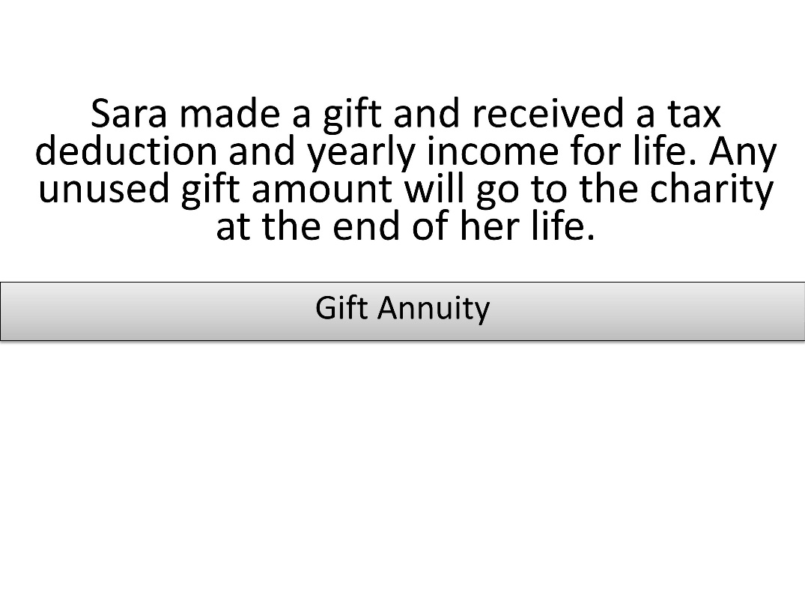
Text only or text and donor picture?
Please rate your interest in pursuing the above described charitable giving arrangement: % Interested now (definitely/somewhat /slightly)
All: ___%
55+: ___%
All: ___%
55+: ___%

Slide 74
Text only or text and donor picture?
Please rate your interest in pursuing the above described charitable giving arrangement: % Interested now (definitely/somewhat /slightly)
All: 38.6%
55+: 38.6%
All: 31.1%
55+: 29.8%

Slide 75
What’s the problem with the donor picture? Is it just this photo? This donor age? Is it photos in general or what?

Slide 76
Interested now (definitely/somewhat /slightly)
55+
___%
___%
___%
35-54
___%
___%
___%
U-35
___%
___%
___%

Slide 77
Interested now (definitely/somewhat /slightly)
55+
24.4%
22.0%
41.1%
35-54
38.4%
47.4%
30.6%
U-35
44.5%
32.6%
30.2%

Slide 78
How do these compare with text only or a non-donor photo?
Text only

Slide 79
Interested now (definitely/somewhat /slightly)
55+
1st 44.4%
3rd 28.3%
24.4%
22.0%
41.1%
35-54
3rd
40.1%
2nd 44.6%
38.4%
47.4%
30.6%
U-35
3rd 34.7%
2nd 36.4%
44.5%
32.6%
30.2%
All
1st 40.1%
2nd 36.5%
35.8%
34.0%
34.0%
Young
Middle Older

Slide 80
Age matched donor pictures are OK
Otherwise, use text only or a different picture

Slide 81
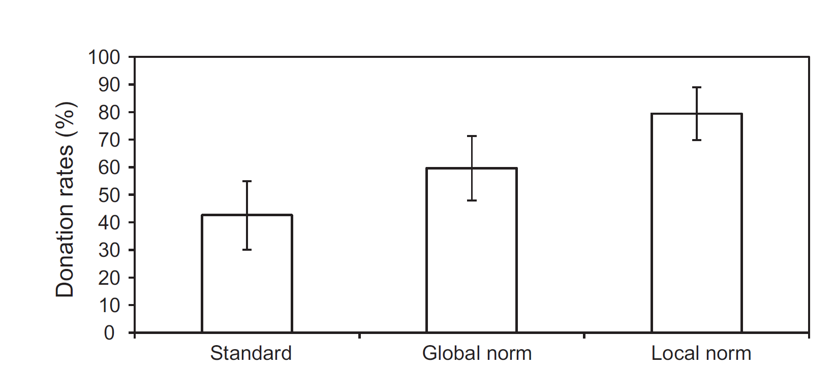
Social norms are more powerful when the examples are like me
You can support Golomolo by donating 20 Swedish crowns.
You can support Golomolo by donating 20 Swedish crowns. 73% of University students in Sweden who were asked for a contribution have donated 20 Swedish crowns to Golomolo.
You can support Golomolo by donating 20 Swedish crowns. 73% of Linnaeus University students who were asked for a contribution have donated 20 Swedish crowns to Golomolo.
Agerström, J., Carlsson, R., Nicklasson, L., & Guntell, L. (2016). Using descriptive social norms to increase charitable giving: The power of local norms. Journal of Economic Psychology, 52, 147-153.

Slide 82
Philanthropy is a SOCIAL act using the mechanisms of FAMILY bonding
SOCIAL examples influence charitable
estate decisions

Slide 83
$7,381 average annual giving post-plan
+$3,171 average annual giving increase
$4,210 average annual giving pre-plan

Slide 84
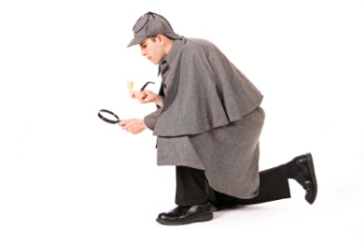
New Survey
Instead of testing question wording, now testing impact of marketing messages for 40 national charities
(4,560 participants)
If you were asked in the next 3 months, what is the likelihood that you might GIVE money to _____?
If you signed a will in the next 3 months, what is the likelihood you might leave a BEQUEST gift to _____?
v.

Slide 85
Baseline | BEQ | Give
Amer Cancer Society | 26.79 | 36.77
The Red Cross | 25.93 | 41.12
ASPCA | 24.18 | 33.77
Habitat for Humanity | 24.01 | 34.90
Amer Heart Association | 23.17 | 33.95
Natl Cancer Coalition | 22.56 | 34.54
Breast Cancer Res Fnd | 22.53 | 33.93
Natl Breast Cancer Fnd | 22.43 | 33.48
The Amer Humane Assn | 22.23 | 33.91
The Alzheimer's Found | 21.40 | 32.00
Susan G. Komen Br Canc | 21.39 | 29.22
Dana Farber Cancer Inst | 21.13 | 29.63
American Diabetes Assn | 20.84 | 32.54
World Wildlife Fund | 20.82 | 29.08
Guide Dogs for the Blind | 20.80 | 31.46
The Alzheimer's Assn | 20.80 | 31.86
American Lung Assn | 20.78 | 31.40
MD Anderson Cancer Cr | 20.59 | 30.53
UNICEF | 20.37 | 32.31
The Salvation Army | 19.98 | 31.44
Baseline | BEQ | Give
Wildlife Conserv Soc | 19.90 | 29.26
Goodwill Industries | 19.65 | 34.42
Big Brothrs/Big Sisters | 19.47 | 30.49
The United Way | 18.97 | 28.97
Joslin Diabetes Center | 18.91 | 29.18
Canine Compan for In | 18.90 | 29.67
Fnd Fightng Blindness | 18.77 | 28.37
AIDS Project LA | 17.71 | 25.64
Prevent Blindss Amer | 17.51 | 28.32
San Fran AIDS Found | 17.39 | 25.49
Nat Audubon Society | 17.33 | 24.24
YMCA | 17.16 | 28.12
Boys and Girls Clubs | 17.14 | 30.10
Girl Scouts | 16.71 | 31.27
YWCA | 16.21 | 24.42
Amer Indian College F | 15.97 | 22.33
CARE | 15.86 | 24.69
Boy Scouts | 14.51 | 23.56
United Negro Coll Fnd | 14.13 | 21.90
Ducks Unlimited | 13.60 | 19.49

Slide 86
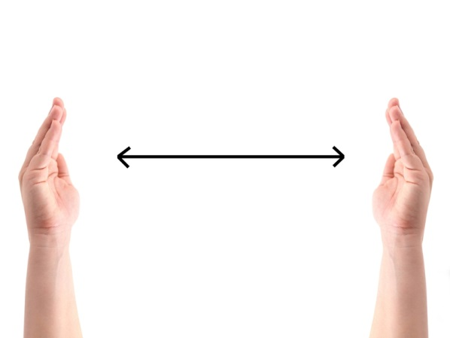
Other groups received messages after the current giving question to see if the bequest gap would shrink

Slide 87
Social Norms
Formal Evidence
Information indicating that it is common for Americans to leave 5% or 10% to charity. Sharing survey results showing agreement with concept.
Spendthrift Heirs
Formal Evidence
Statistics showing how rapidly heirs typically spend inheritance from published academic research
Message | Give-BEQ Gap | Gap 50+ | Gap Male | Gap Female
None | 10.2 | 14.0 | 7.7 | 11.7
Spendthrift Heirs (Formal) | 9.4 | 11.4 | 8.4 | 10.1
Social Norms (Formal) | 8.8 | 11.7 | 7.5 | 9.7
Heirs + Social Norms | 8.0 | 10.2 | 6.4 | 9.0

Slide 88
Family words
(simple language and LIFE STORIES)
outperform
formal words
(technical, contract, market terms)
Philanthropy is a SOCIAL act using the mechanisms of FAMILY bonding
SOCIAL examples influence charitable
estate decisions

Slide 89
Living bequest donor life stories
E.g., “School janitor Lester Holmes died in 1992” becomes “School janitor Lester Holmes signed his will today”
With new images or pure text (no significant difference)
Message | Give-Beq Gap | Gap 50+ | Gap Male | Gap Female
None | 10.2 | 14.0 | 7.7 | 11.7
Spendthrift Heirs (Formal) | 9.4 | 11.4 | 8.4 | 10.1
Social Norms (Formal) | 8.8 | 11.7 | 7.5 | 9.7
Heirs + Social Norms | 8.0 | 10.2 | 6.4 | 9.0
Deceased Beq. Stories | 6.7 | 7.5 | 4.4 | 7.5
Living Bequest Stories | 4.4 | 4.3 | 3.3 | 5.0

Slide 90
References to “important in your life” increase interest
2014 & 2015 Surveys, 1,822 Respondents
Will Never Be Interested
6%
7%
14%
Interested Now
40%
30%
12%
Make a gift to charity in your will to support causes that have been important in your life
Make a gift to charity in your will
Make a bequest gift to charity

Slide 91
“important in their lives” increases power of social norm
Nov 2014 Survey, 1363 Respondents
Will Never Be Interested
7%
9%
Interested Now
35%
31%
Many people like to leave a gift to charity in their will because they care about causes that are important in their lives. Are there any causes you would support in this way?
Many people like to leave a gift to charity in their will. Are there any causes you would support in this way?

Slide 92
Tell as many life stories of living planned donors in as many places as possible
This helps to set a social norm by example using appropriate language
Philanthropy is a SOCIAL act using the mechanisms of FAMILY bonding
START with the donor’s life story, not the charity’s immediate need

Slide 93
Ask about family connections to the cause
Share the option of honoring a family member by making a tribute gift to charity in the will
Philanthropy is a SOCIAL act using the mechanisms of FAMILY bonding

Slide 94
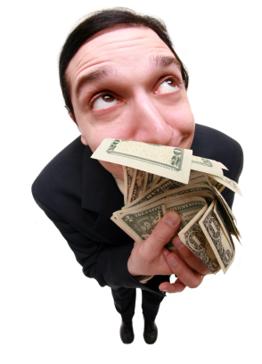
Social Desirability Bias
People are unlikely to report giving as motivated by personal benefits like tax deductions
The motivational effects of tax benefits are clear when measured directly
Philanthropy is a SOCIAL act using the mechanisms of FAMILY bonding

Slide 95
Mentioning tax deductions increases charitable interest
2014 Survey, 1,904 Respondents, Groups D/E/F
Will Never Be Interested
8%
14%
20%
Interested Now
50%
33%
31%
Receive a tax deduction and make a gift that pays you income for life.
Make a gift that pays you income for life and receive a tax deduction.
Make a gift that pays you income for life.

Slide 96
Mentioning tax deductions increases charitable interest
2014 Survey, 1,826 Respondents, Groups F/B/D
Will Never Be Interested
23%
33%
42%
Interested Now
26%
12%
11%
Immediately receive a tax deduction for 70% of the value
of a house or land by making a charitable gift of the property, but keeping the RIGHT TO USE it for the rest of your life.
Make a charitable gift of either a house or land, but keep the RIGHT TO USE for the rest of your life and immediately receive a tax deduction for 70% of the value of the property.
Make a charitable gift of either a house or land, but keep the RIGHT TO USE it for the rest of your life.

Slide 97
Mentioning tax deductions increases charitable interest
2014 Survey, 1,782 Respondents, Groups E/A/C
Will Never Be Interested
17%
20%
25%
Interested
Now
28%
27%
21%
Get an immediate tax deduction by making a gift where you still control the
investment of the assets, and receive
income from the investments for the rest of your life with anything left over going to charity at your death.
Make a gift where you get an immediate tax deduction, still control the investment of the assets and receive income from the investments for the rest of your life with anything left over going to charity at your death.
Make a gift where you still control the investment of the assets, and receive income from the investments for the rest of your life with anything left over going to charity at your death.

Slide 98
Mentioning tax avoidance increases charitable interest
2014 Nov. Survey, 1,006 Respondents, Groups X/Y
Will Never Be Interested
8%
20%
Interested Now
50%
31%
Avoid capital gains tax by making a gift of stocks or bonds to a charity.
Make a gift of stocks or bonds to charity.

Slide 99
Social Desirability Bias
It is good to note benefits,
but don’t identify personal benefits as the motivation
Philanthropy is a SOCIAL act using the mechanisms of FAMILY bonding
People who join the legacy society make a “second gift” because their example can influence others to make the same commitment.
People join the legacy society so that everyone will know how philanthropic they are.

Slide 100
Should you reference tax benefits?
How should you do so?

Slide 101
I might be/am definitely interested
Please rate your level of interest in clicking on the button to read the corresponding information.
__%
__%
__%
__%
__%
__%
Avoid taxes by giving stocks
How to avoid taxes by giving stocks
Save taxes by giving stocks
Tax tips when giving stocks
Avoiding capital gains taxes by giving stocks
Giving stocks

Slide 102
I might be/am definitely interested
Please rate your level of interest in clicking on the button to read the corresponding information.
28%
27%
25%
24%
24%
16%
Avoid taxes by giving stocks
How to avoid taxes by giving stocks
Save taxes by giving stocks
Tax tips when giving stocks
Avoiding capital gains taxes by giving stocks
Giving stocks

Slide 103
Age and gender differences

Slide 104
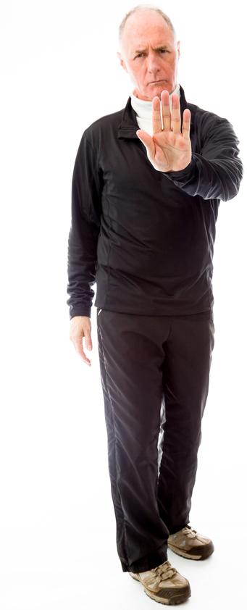
A larger share of older adults are decidedly resistant to bequest giving and planned giving
Difference in older (50+) v. all respondents
Questions | I Will Never Be Interested | Definitely Interested Now
All gift of cash | +0.1% | +2.4%
All bequest gift | +8.5% | +0.6%
All tribute bequest | +10.1% | -0.2%
All TOD | +13.2% | -0.2%
All donor advised fund | +13.9% | -0.2%
All gift of stocks/bonds | +14.3% | +0.0%
All retained life estate | +15.9% | -0.9%
All CGA | +16.8% | -2.3%
All CRT | +25.2% | -1.9%

Slide 105
Older adults are initially more resistant to bequest giving but more responsive to bequest marketing

Slide 106
{
Older adults are initially more resistant to bequest giving but are more responsive to bequest giving marketing
{
{
{
{
{
{
{
}

Slide 107
Older adults initially more resistant to tribute bequest concept (survey #1) but more responsive to tribute bequest reminder (#2)
Average share with family/friend connections to each cause
 | Total | Age 50+
Memorial reminder | 22.1% | 27.1%
Living reminder | 34.2% | 36.1%
Will Never Be Interested
 | All | 50+
All tribute bequest | 20.3% | 30.4%
Change in charitable bequest intention for those with family/friend connection
 | Total | Age 50+
Memorial reminder | +13.97 | +13.96
Living reminder | +9.22 | +9.33

Slide 108
Women have relatively higher interest in cash gifts, equal for bequest gifts, lower for other planned giving

Slide 109
What
job titles
work best for donors?

Slide 110
Would
definitely
contact
Very
likely
to contact
Somewhat
likely
to contact
Somewhat
unlikely
to contact
Very
unlikely
to contact
Would
never
contact
Who at the charity are you
more likely to contact?
Gift of stock
Real estate gift
Charitable gift annuity
Gift in a will
5,621 People Surveyed.
Each person chose from only 13 titles for each scenario. Scenarios and titles were rotated among ten different respondent groups balancing alphabetical and reverse alphabetical title order.

Slide 111
Tested 71 Titles
Chief Advancement Officer; Advancement Development; Business Development; Campaign; Charitable Estate Planning; Development; Donor Development; Donations Consultant; Donor; Donor Assistant; Donor Counselor; Donor Ombudsman; Donor Relations; Estates; Executive; External Relations; Finance; Financial; Financial Advisor for Donors; Fundraising; Gift Planner; Gift Planning; Individual Giving; Institutional Advancement; Leadership Gifts; Legacy Planning; Major Gifts; Philanthropic Strategist; Planned Gifts; Planned Giving; Real Estate Gifting; Resource Development; Special Gifts; Stewardship
Director of Advancement; Advancement Development; Advancement/Planned Giving; Annual Giving; Charitable Estate Planning; Charitable Planning; Complex Gifts; Development; Development & Marketing; Donor Advising; Donor Assistance; Donor Development; Donor Relations; Donor Guidance; Estate & Gift Planning; Estates; Finance; Fundraising; Institutional Advancement & Gift Planning; Institutional Advancement; Legacy Planning; Major Gifts; Major Gifts & Legacy Planning; Personal Philanthropy; Philanthropic Opportunities; Philanthropy; Planned Gifts; Planned Gifts & Grants; Planned Giving; Planned Giving & Estate Administration; Planned Giving & Finance; Planned Giving Development; Resource Development; Stewardship; Stewardship & Development; Trusts & Estates; Trusts, Estates & Gift Planning

Slide 112
Suppose you receive $100,000 in corporate stock from a relative. You are considering gifting some of these shares to a large charity, but you want to do it in a way that saves the most taxes.
Who at the charity are you more
likely to contact?

Slide 113
Gift of Stock
Best 10 Titles (of 66 tested)
(do) Planned Giving & Finance
(co) Financial Advisor for Donors
(do) Donor Advising
(do) Institutional Advancement & Gift Planning
(do) Trusts, Estates & Gift Planning
(co) Donor Relations
(do) Estate & Gift Planning
(co) Donor Officer
(do) Donor Guidance
(do) Charitable Planning
Worst 10 Titles (of 66 tested)
(do) Advancement
(co) Advancement
(co) Business Development
(co) Real Estate Gifting
(do) Institutional Advancement
(co) Institutional Advancement
(co) Campaign
(do) Development Marketing
(co) External Relations
(do) Development

Slide 114
How big of a difference?
Gift of Stock
Would Definitely Contact
22%
18%
7%
2014-2015 Survey, 2,151 Responses
Would Never Contact
7%
7%
25%
Director of
Donor Advising
Chief Donor
Relations Officer
Director of Advancement

Slide 115
Suppose you own some real estate and you are thinking about giving part of it to a charity, but you want to do it in the right way.
Who at the charity are you more likely to contact?

Slide 116
Gift of Real Estate
Best 10 Titles (of 68 tested)
(co) Real Estate Gifting
(co) Gift Planner
(do) Estate & Gift Planning
(do) Planned Giving & Estate Administration
(do) Trusts, Estates & Gift Planning
(do) Charitable Estate Planning
(co) Donor
(do) Trusts & Estates
(do) Charitable Estate Planning
(co) Donor Relations
Worst 10 Titles (of 68 tested)
(do) Advancement
(do) Development & Marketing
(co) Advancement
(do) Institutional Advancement
(do) Development
(do) Advancement Development
(co) Business Development
(co) Executive
(co) External Relations
(co) Donor Ombudsman

Slide 117
You read in a newspaper article about a plan where you can receive a tax deduction and make a gift that pays you income for life.
Who at the charity are you more likely to contact to ask about this?

Slide 118
Charitable Gift Annuity
Best 10 Titles (of 71 tested)
(co) Financial Advisor for Donors
(do) Planned Giving & Finance
(do) Donor Advising
(do) Planned Giving
(do) Trusts, Estates & Gift Planning
(do) Advancement & Planned Giving
(do) Planned Gifts & Grants
(co) Gift Planning
(co) Individual Giving
(co) Donations Consultant
Worst 10 Titles (of 71 tested)
(co) Campaign
(co) Advancement Development
(co) Advancement
(co) Institutional Advancement
(do) Institutional Advancement
(do) Advancement Development
(do) Advancement
(co) Development
(co) Resource Development
(do) Development & Marketing

Slide 119
Suppose you are getting ready to write a new will. You are considering including a charity, but you want to use the right language for the gift.
Who at the charity are you more likely to contact?

Slide 120
Charitable Will
Best 10 Titles (of 70 tested)
(do) Trusts, Estates & Gift Planning
(do) Estate & Gift Planning
(do) Planned Giving & Estate Administration
(do) Donor Guidance
(do) Charitable Estate Planning
(do) Legacy Planning
(do) Donor Advising
(do) Trusts & Estates
(do) Major Gifts & Legacy Planning
(co) Gift Planning
Worst 10 Titles (of 70 tested)
(do) Development & Marketing
(do) Institutional Advancement
(do) Advancement
(co) Business Development
(co) Advancement
(do) Development
(do) Resource Development
(co) Advancement Development
(co) Institutional Advancement
(co) Campaign

Slide 121
All four scenarios combined.
Who at the charity are you more likely to contact?
Best 10 Titles (63 tested in all cases)
(do) Trusts, Estates & Gift Planning
(co) Financial Advisor for Donors
(do) Estate & Gift Planning
(do) Planned Giving & Finance
(do) Donor Advising
(do) Planned Giving & Estate Administration
(do) Charitable Estate Planning
(co) Gift Planner
(do) Charitable Planning
(co) Donor Guidance
Worst 10 Titles (63 tested all cases)
(do) Advancement
(do) Institutional Advancement
(co) Advancement
(do) Development & Marketing
(co) Business Development
(co) Institutional Advancement
(co) Advancement Development
(do) Development
(do) Advancement Development
(co) External Relations

Slide 122
Among Adults Age 50+
Best 10 Titles (of 63 tested in all scenarios)
(do) Trusts, Estates & Gift Planning
(do) Estate & Gift Planning
(do) Planned Giving & Finance
(do) Charitable Estate Planning
(co) Financial Advisor for Donors
(do) Planned Giving & Estate Administration
(co) Gift Planner
(co) Charitable Estate Planning*
(co) Planned Giving*
(do) Planned Giving*
*not in overall top 10
Worst 10 Titles (of 63 tested in all scenarios)
(do) Advancement
(do) Institutional Advancement
(co) External Relations
(co) Advancement
(co) Institutional Advancement
(do) Development & Marketing
(do) Development
(co) Resource Development*
(do) Advancement Development
(co) Advancement Development
*not in overall bottom 10

Slide 123
Among Women
Best 10 Titles (of 63 tested in all scenarios)
(do) Trusts, Estates & Gift Planning
(co) Financial Advisor for Donors
(do) Estate & Gift Planning
(do) Planned Giving & Finance
(do) Donor Advising
(do) Planned Giving & Estate Administration
(do) Charitable Estate Planning
(co) Gift Planner
(co) Donor Guidance
(do) Planned Giving
*not in original top 10
Worst 10 Titles (of 63 tested in all scenarios)
(do) Advancement
(do) Development & Marketing
(do) Institutional Advancement
(co) Advancement
(do) Development
(do) Advancement Development
(co) Advancement Development
(co) Business Development
(co) Institutional Advancement
(co) External Relations

Slide 124
Among Men
Best 10 Titles (of 63 tested in all scenarios)
(do) Estate & Gift Planning
(co) Financial Advisor for Donors
(do) Planned Giving & Finance
( (do) Trusts, Estates & Gift Planning
(do) Planned Giving & Estate Administration
(do) Donor Advising
(do) Charitable Planning
(co) Donations Consultant*
(do) Charitable Estate Planning
(co) Major Gifts & Legacy Planning
Worst 10 Titles (of 63 tested in all scenarios)
(do) Institutional Advancement
(do) Advancement
(co) Advancement
(do) Development & Marketing
(co) Business Development
(co) Institutional Advancement
(co) Advancement Development
(co) External Relations
(do) Development
(co) Development
*not in overall top 10

Slide 125
Among Substantial Donors
$1,000 - $100,000 gifts
Best 10 Titles (of 63 tested in all scenarios)
(co) Financial Advisor for Donors
(do) Trusts, Estates & Gift Planning
(do) Planned Giving & Finance
(do) Estate & Gift Planning
(do) Donor Advising
(do) Planned Giving & Estate Administration
(do) Charitable Planning
(co) Planned Giving*
(do) Charitable Estate Planning
(co) Planned Gifts*
Worst 10 Titles (of 63 tested in all scenarios)
(co) Executive*
(co) Campaign*
(do) Resource Development*
(do) Institutional Advancement
(do) Development & Marketing
(do) Advancement
(co) Advancement Development
(co) Business Development
(co) Advancement
(co) Institutional Advancement
*not in overall bottom 10
*not in overall top 10

Slide 126
Do we communicate with donor language or insider language?

Slide 127
Use family words (stories and simple words) not formal words
Use social examples/norms
Tell life stories of planned donors
Talk about benefits – in the right way
Ask about family connections to the cause and give the option of a tribute gift in the will
Communicate obliquely (use non-death-related packaging)
Keep communicating to older donors to be top of the mind at the point of decision.
Philanthropy as synthetic family: a SOCIAL act using the mechanisms of FAMILY bonding

Slide 128
Avoid death reminders
Previous findings
People are less interested in “make a gift to charity in my last will & testament that
will take effect at my death” than when the final phrase is removed.
Stories of living bequest donors are more influential than otherwise identical stories of deceased bequest donors
New finding
Replacing “if the annuity holder lives
up to different ages” with
“depending on the age when the
annuity holder dies” and “each year you live” with “until you die” reduces those interested in purchasing an annuity from 36% to 26%.
Solving the annuity puzzle: The role of mortality salience in retirement savings decumulation decisions, Journal of Consumer Psychology, 26(3), 2016, 417-425 L. C. Salisbury & G. Y. Nenkov

Slide 129
What about other estate giving phrases?
“leave a legacy” or “continue my support”?

Slide 130
“Leave a legacy” not helpful
2014 Survey, 1,072 Respondents, Group G-early/C
Will Never Be Interested
14%
12%
Interested Now
22%
26%
Leave a legacy gift to charity in my last will & testament
Make a gift to charity in my last will & testament

Slide 131
“Remember your favorite charities” not helpful
2014 Fall Survey, 583 Respondents
Will Never Be Interested
10%
7%
Interested Now
27%
30%
Make a gift to charity in your will to remember your favorite charities
Make a gift to charity in your will

Slide 132
“Continue my support” had mildly negative results
2014-2015 Surveys, 2,135 Respondents, 1st, Spring, 1090, 2nd Jan, 607, 3rd Fall, 438
Make a gift to charity in my last will & testament
Continue my support of my favorite charities through a gift in my last will & testament
>
Make a gift to charity in your will to support causes that have been important in your life.
Make a gift to charity in your will to continue to support causes that have been important in your life.
>
Many people like to leave a gift to charity in their will because they want to continue to support causes that are important in their lives
Many people like to leave a gift to charity in their will because they care about causes that are important in their lives
>

Slide 133
Any special phrasing for bank account or retirement account
transfer-on-death beneficiary designations?

Slide 134
Slight improvement with a percentage option
2014 Survey, 2,214 Respondents, Groups G/H/D
Will Never Be Interested
24.1%
29.0%
25.6%
Interested Now
14.4%
14.0%
11.6%
Make a gift by naming a charity as a transfer-on-death beneficiary
for some percentage of a bank account or retirement account.
Make a gift by naming a charity as a transfer-on-death beneficiary
for 10% of a bank account or retirement account.
Make a gift by naming a charity as a transfer-on-death beneficiary on a bank account or retirement account.

Slide 135
“Make a gift” or “Leave a gift” no difference
2014 Survey, 1,246 Respondents, Groups D/E
Will Never Be Interested
26%
26%
Interested Now
12%
12%
Make a gift by naming a charity as a transfer-on-death beneficiary on a bank account or retirement account.
Leave a gift by naming a charity as a transfer-on-death beneficiary on a bank account or retirement account.

Slide 136
Don’t use “Bequest”
2014 Survey, 1,203 Respondents, Groups D/C
Will Never Be Interested
26%
31%
Interested Now
12%
9%
Make a gift by naming a charity as a transfer-on-death beneficiary on a bank account or retirement account.
Make a bequest gift by naming a charity as a beneficiary on a bank account or retirement account.

Slide 137
Words That Work
The phrases that encourage planned giving

